Slide 1
National Emergency Laparotomy Audit
Improving Patient Care
www.nela.org.uk info@nela.org.uk

Slide 2

Summary of year 3 results
Trends in national picture
How NELA might change in next few years

Slide 3
NELA participation so far…
Clinician Engagement
Year 1: 21,000 patients from 191/195 hosps
  65% case ascertainment
Year 2: 23,000 patients from 186/191 hosps
  70% case ascertainment
Year 3: 25,000 patients from 187/191 hosps
  80% case ascertainment

Slide 4
Year 3: 25,000 patients (83%) from 187 hospitals
  Personal practice still improving
  Organisational change still challenging
Still considerable variation
4

Slide 5
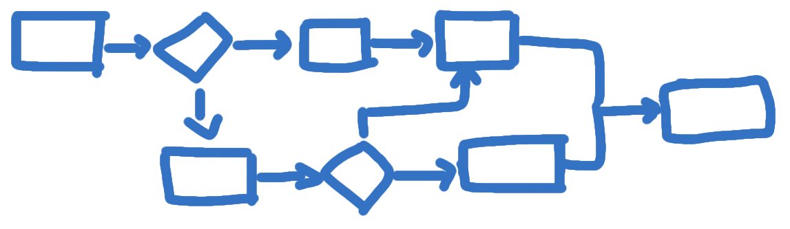
i)Processes

Slide 6
Risk Assessment:
Still some improvement needed
Notes:
Recognition of importance
Appreciation of risk key to providing appropriate level of care
But whose job is it?

Slide 7
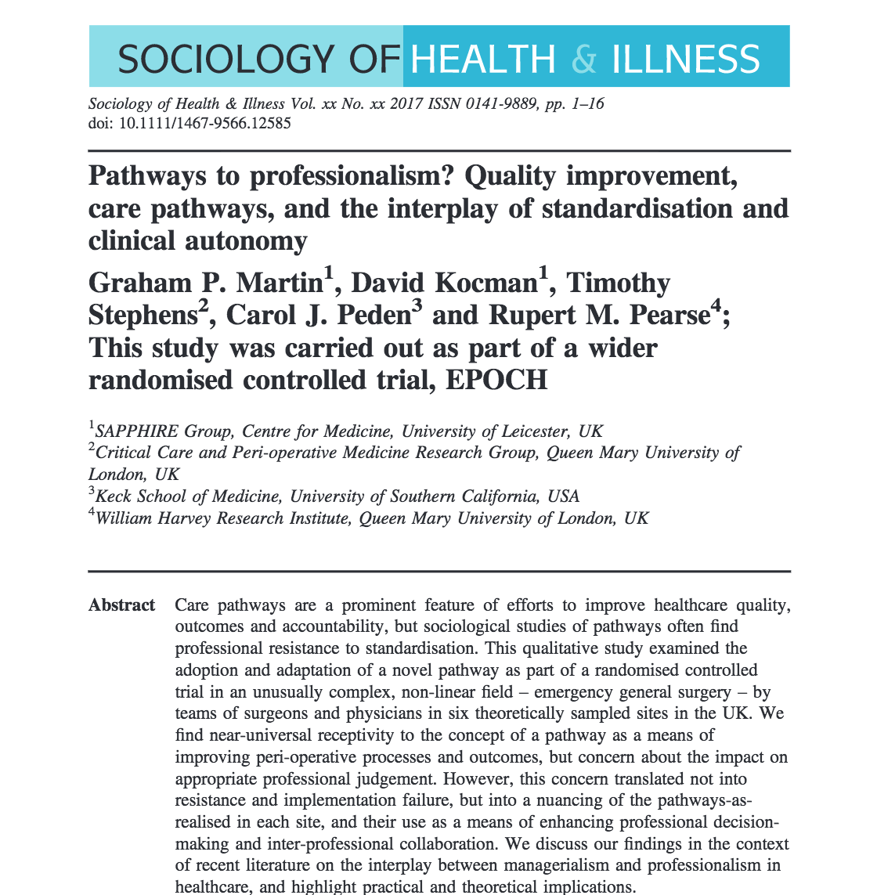
Risk Assessment
Assessment, appreciation and communication of risk leads to better standards of care
Key aim to improve care is to improve risk assessment

Slide 8
P-POSSUM calibration

Slide 9
POSSUM implications
Useful for allocation of resources if mortality risk <15%
Falsely reassuring for O:E mortality calculations, especially at higher risk
Recalibrated mortality now NELA website and app

Slide 10
NELA risk score

Slide 11
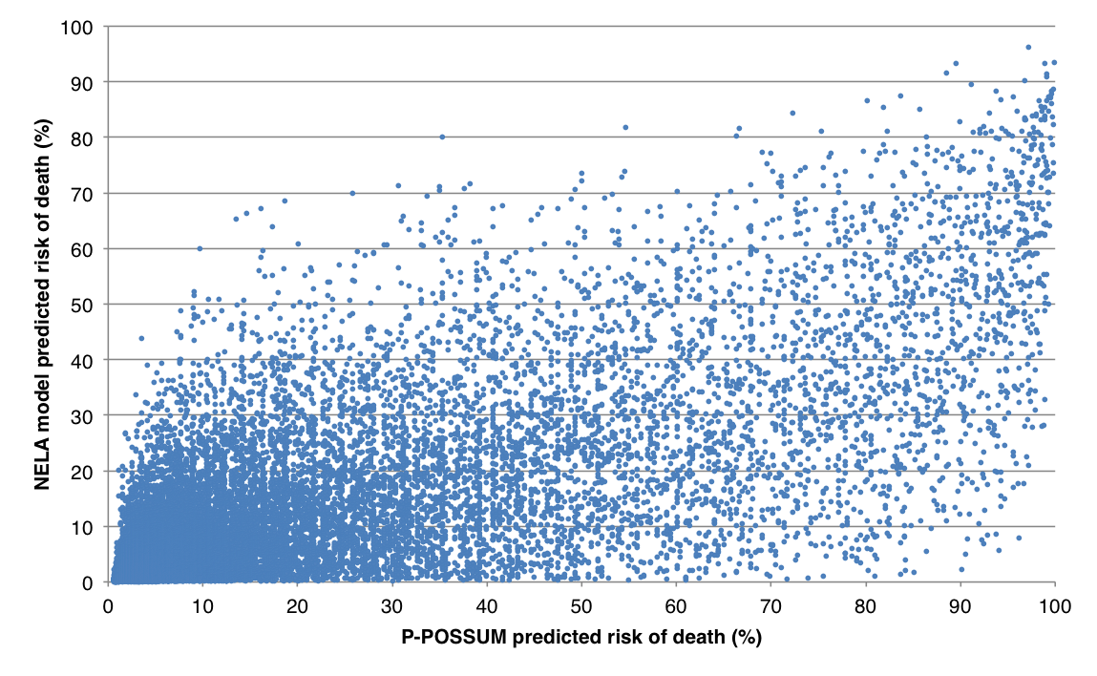
NELA vs P-POSSUM

Slide 12
Timely access to theatre
51 hospitals have expanded theatre capacity

Slide 13
Consultant in theatre for high risk patients (≥5% mortality)
Notes:
Trust/department decision + adjustment to behaviour at an individual level

Slide 14
Critical care admission

Slide 15
Critical care admission
>10% 5-10%

Slide 16
Stubborn challenges: Elderly Care
Notes:
Requires a more system wide change – policy and adequate provision of service
Proactive not reactive

Slide 17
Number of standards being met
Number of hospitals rated Green
Number of standards met

Slide 18
Number of standards being met
Number of hospitals rated Green
Number of standards met

Slide 19
Number of standards being met
Number of hospitals rated Green
Number of standards met

Slide 20
Improving infrastructure

Slide 21

Outcomes

Slide 22
Risk-adjusted ONS 30-day mortality

Slide 23
Trends in crude ONS 30-day and 90-day mortality
Notes:
Trend in the overall ONS 30-day and 90-day mortality percentage rate (split medians denoting the
change from Year 1 to Year 2)

Slide 24
ONS 30-day and 90-day mortality by age group

Slide 25
30-day mortality
Year 1 11.8%
Year 2 11.5%
Year 3 10.6%

Slide 26

30-day mortality
Year 1 11.8%
Year 2 11.5%
Year 3 10.6%

Slide 27
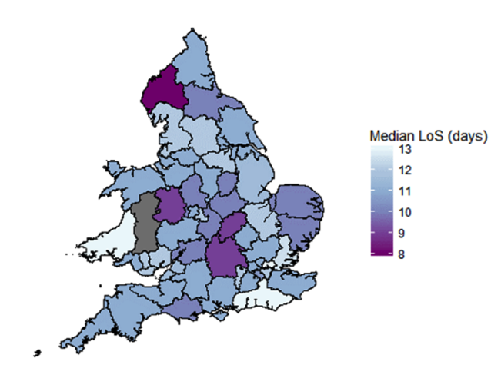
Reduction in Length of Stay
19.2 to 16.6 days
£30 million annual savings

Slide 28
Going forwards…
Greater emphasis on QI
More frequent public reporting
RAG rating boundaries will increase
Mandatory and discretionary measures
Best Practice Tariff

Slide 29
What next for NELA/NELQIP?
Greater emphasis on QI
Targeted /themed reporting, eg commissioners
Secondary research
Parsimonious risk model

Slide 30

The Problem With Audit
Data
Notes:
Reflects the external drivers for change. Political document.
30

Slide 31
The Problem With Audit
Data
Local QI
Notes:
Reflects the external drivers for change. Political document.
31

Slide 32


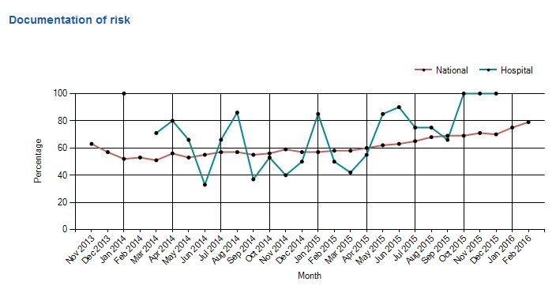
data.nela.org.uk

Slide 33
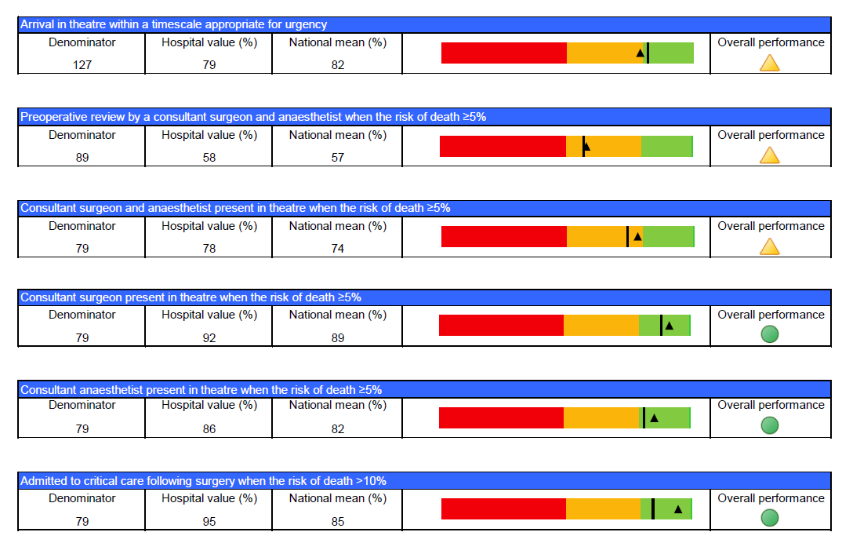
Publically available quarterly reports
Discretionary & mandatory metrics
These will change!

Slide 34
Best Practice Tariff
Consultant presence?
Theatre on time?
Critical care?
Elderly care?

Slide 35



Research…
www.epochtrial.org
www.floela.org

Slide 36
Ongoing projects
NELA Surgical sub-speciality analysis Perforated peptic ulcer (AUGIS)
Subtotal colectomy for colitis (ACPGBI) Bowel Obstruction (ASGBI)
Hartmann’s (ACPGBI)
Bowel Cancer (ACPGBI)
NELA Risk Tool
Replace / augment P-POSSUM
Notes:
NELA data has been used to inform and improve local practice, as a platform to disseminate best practice and compare standards across the country. Most of the NELA data has been collected and used by the anaesthetic fraternity. However it is recognised that there is wealth of data available. Several of the subspecialty surgical organisations have already tapped into the NELA data resource to allow analysis for specific surgical conditions. There are many ongoing projects several of which you will hear about at this congress.
IN addition NELA have been in the process of formulating and validating their own risk tool. The risk tool will be available as an APP and on the web site in the coming days .

Slide 37
Risk of death and observed ONS 30-day & 90-day mortality
Notes:
Median calculated preoperative P-POSSUM risk of death, and observed ONS 30-day and 90-day mortality by documented preoperative risk category (Year 2 data)

Slide 38
Steal Shamelessly
38
Notes:
The aim of this is to allow hospitals to find who has got XYZ policy, so that they can adapt it for their own use (esp if they can find somewhere similar to their own hospital). Do not re-invent the wheel . NHS very good at this! Steal Shamelessly – comes from Quality Improvement work. If someone is doing it well, do what they are doing, don’t reinvent it again.

Slide 39
Summary
Thank you for:
75,000+ patients
Improvement seen at personal level
Risk Assessment drives resources
Need organisational change
Not “National Audit”,
but local Quality Improvement

